Slide 1


Slide 2
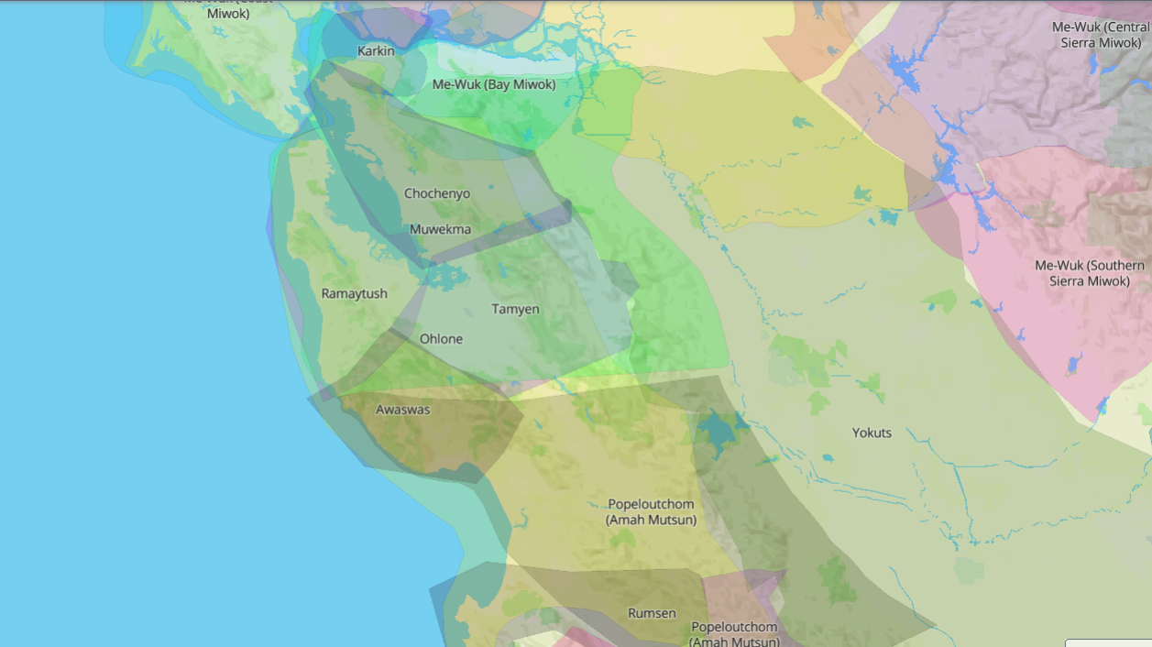

Slide 3

The Pyramid of Truth
Common Language and Terms
Respectful Communication and Mutual Invitation
Session 2
Feb 24, 2021
“Believe Differently”

Slide 4
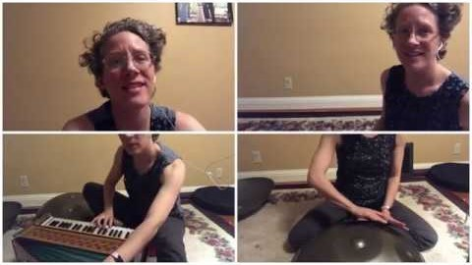

Slide 5
Respectful Communication Guidelines
R = take RESPONSIBILITY for what you say and feel without blaming others.
E = use EMPATHETIC listening.
S = be SENSITIVE to differences in communication styles.
P = PONDER what you hear and feel before you speak.
E = EXAMINE your own assumptions and perceptions.
C = keep CONFIDENTIALITY.
T = TRUST ambiguity because we are not here to debate who is right or wrong.

Slide 6
Mutual Invitation
(from The Wolf Shall Dwell With the Lamb by Eric H. F. Law)
The Process:
In order to ensure that everyone who wants to share has the opportunity to speak, we will proceed in the following way:
  The leader or a designated person will share first. After that person has spoken, he or she then invites another to share. Whom you invite does not need to be the person next to you. After the next person has spoken, that person is given the privilege to invite another to share.

Slide 7
Mutual Invitation
(from The Wolf Shall Dwell With the Lamb by Eric H. F. Law)
The Process:
In order to ensure that everyone who wants to share has the opportunity to speak, we will proceed in the following way:
If you are not ready to share yet, say “I pass for now” and we will invite [you to share later on]. If you don’t want to say anything at all, simply say “pass” and proceed to invite another to share. We will do this until everyone has been invited.

Slide 8
Mutual Invitation
(from The Wolf Shall Dwell With the Lamb by Eric H. F. Law)
The Process:
In order to ensure that everyone who wants to share has the opportunity to speak, we will proceed in the following way:
We invite you to listen and not to respond to someone’s sharing immediately. There will be time to respond and to ask clarifying questions after everyone has had an opportunity to share.

Slide 9
Kaleidoscope Bible Study Process
1. Read the Respectful Communication Guidelines and invite members of the group to affirm them for their time together.
2. Inform participants that the Bible passage will be read 3 times. After each reading, participants will be invited to share their reflections.
3. Invite participants to capture a word, a phrase or image when listening to the passage the first time.
4. Invite someone to read the passage.

Slide 10
Kaleidoscope Bible Study Process
5. A moment of silence to capture a word, a phrase or image that stood out from the passage for them.
6. Using Mutual Invitation, invite each person to share his or her word, phrase or image briefly. (This should take no more than 5 minutes.)
7. Invite participants to consider the second question appointed for this passage.
“What do you groan for in cross-racial relationships?”
8. Invite someone to read the passage a second time.

Slide 11
Kaleidoscope Bible Study Process
9. A moment of silence to reflect on the question.
10. Using Mutual Invitation, invite each person to share his or her reflection.
11. Invite participants to consider the following question while listening to the passage again.
“What does God invite you to do, be or change through this passage?”
12. Invite someone to read the passage a third time.

Slide 12
Kaleidoscope Bible Study Process
13. A moment of silence to reflect on the question.
14. Using Mutual Invitation, invite each person to share his or her reflection.
End the session with a prayer circle:
Invite participants to join hands in a circle.
Invite each person to mentally complete the sentences:
I thank God today . . .
I ask God today . . .
The leader will begin by sharing his or her prayers. After he or she has shared, the leader then squeezes the hand of the person to the right. That will be the signal for the next person to share his or her prayers.
If the person does not want to share, he or she can simply pass the pulse to the next person. When the pulse comes back to the leader, he or she can begin the Lord’s Prayer and invite everyone to join in.

Slide 13
Romans 8:19-23
19 The whole creation waits breathless with anticipation for the revelation of God’s sons and daughters. 20 Creation was subjected to frustration, not by its own choice—it was the choice of the one who subjected it—but in the hope 21 that the creation itself will be set free from slavery to decay and brought into the glorious freedom of God’s children.
22 We know that the whole creation is groaning together and suffering labor pains up until now. 23 And it’s not only the creation. We ourselves who have the Spirit as the first crop of the harvest also groan inside as we wait to be adopted and for our bodies to be set free.

Slide 14
Watch
“The Difference Between Us: Race—The Power of an Illusion” (username: posf | password: digital)
Work through
Pages 39-46
Blog
Topic: An “Aha!” moment from the video
Form
Signups for opening and closing prayers: Form to Signup
Homework

Slide 15


