Slide 1
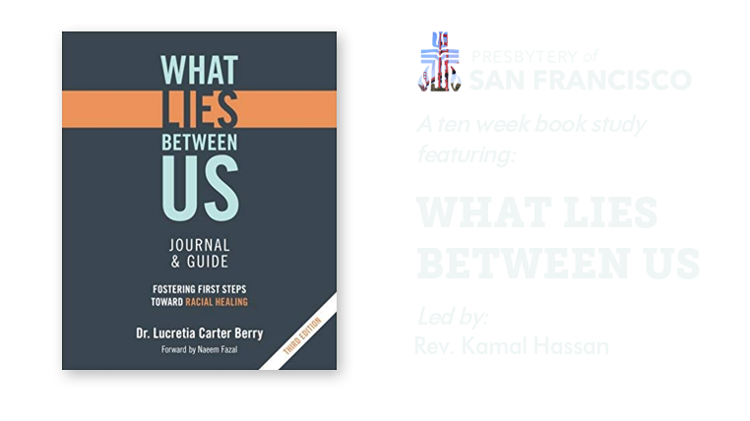

Slide 2
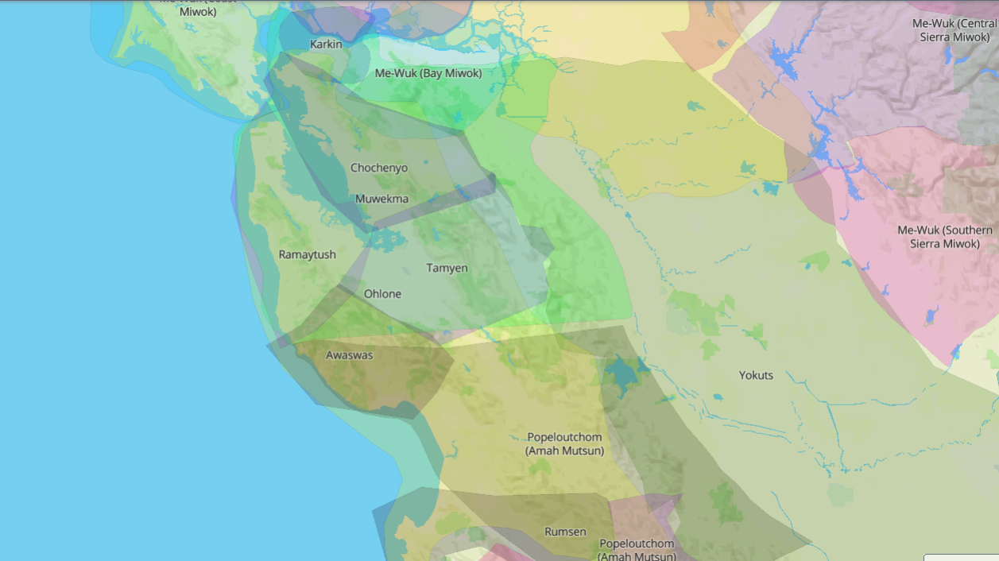

Slide 3

How has the race narrative affected your sense of identity?
Small group conversation
Session 4
Mar 24, 2021
“A Lie Perpetuated”

Slide 4
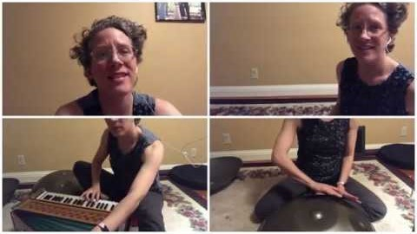

Slide 5
Respectful Communication Guidelines
R = take RESPONSIBILITY for what you say and feel without blaming others.
E = use EMPATHETIC listening.
S = be SENSITIVE to differences in communication styles.
P = PONDER what you hear and feel before you speak.
E = EXAMINE your own assumptions and perceptions.
C = keep CONFIDENTIALITY.
T = TRUST ambiguity because we are not here to debate who is right or wrong.

Slide 6
Kaleidoscope Bible Study Process
1. Read the Respectful Communication Guidelines and invite members of the group to affirm them for their time together.
2. Inform participants that the Bible passage will be read 3 times. After each reading, participants will be invited to share their reflections.
3. Invite participants to capture a word, a phrase or image when listening to the passage the first time.
4. Invite someone to read the passage.

Slide 7
Kaleidoscope Bible Study Process
5. A moment of silence to capture a word, a phrase or image that stood out from the passage for them.
6. Using Mutual Invitation, invite each person to share his or her word, phrase or image briefly. (This should take no more than 5 minutes.)
7. The question appointed for this passage.
”What do you wait for as a sign of change in how America’s racial narrative has affected your identity?
8. Invite someone to read the passage a second time.

Slide 8
Kaleidoscope Bible Study Process
9. A moment of silence to reflect on the question.
10. Using Mutual Invitation, invite each person to share his or her reflection.
11. Invite participants to consider the following question while listening to the passage again.
“What does God invite you to do, be or change through this passage?”
12. Invite someone to read the passage a third time.

Slide 9
Kaleidoscope Bible Study Process
13. A moment of silence to reflect on the question.
14. Using Mutual Invitation, invite each person to share his or her reflection.
End the session with a prayer circle:
Invite participants to join hands in a circle.
Invite each person to mentally complete the sentences:
I thank God today . . .
I ask God today . . .
The leader will begin by sharing his or her prayers. After he or she has shared, the leader then squeezes the hand of the person to the right. That will be the signal for the next person to share his or her prayers.
If the person does not want to share, he or she can simply pass the pulse to the next person. When the pulse comes back to the leader, he or she can begin the Lord’s Prayer and invite everyone to join in.

Slide 10
Romans 8:19-23
19 The whole creation waits breathless with anticipation for the revelation of God’s sons and daughters. 20 Creation was subjected to frustration, not by its own choice—it was the choice of the one who subjected it—but in the hope 21 that the creation itself will be set free from slavery to decay and brought into the glorious freedom of God’s children.
22 We know that the whole creation is groaning together and suffering labor pains up until now. 23 And it’s not only the creation. We ourselves who have the Spirit as the first crop of the harvest also groan inside as we wait to be adopted and for our bodies to be set free.

Slide 11
We will Breakout into our Bible Study Groups
for 25 minutes.
Question for this passage:
”What do you wait for as a sign of change in how America’s racial narrative has affected your identity?
Upon return we’ll have some group discussion around the first 2 episodes—Race: The Power of Illusion.
Question for our group discussion:
"How has the race narrative in America affected your sense of identity?"

Slide 12
Welcome Back!
Group Discussion
"How has the race narrative in America affected your sense of identity?"

Slide 13
Watch
“The House We Live In: Race—The Power of an Illusion” (username: posf | password: digital)
Work through
Pages 57-67
NEXT CLASS
Wednesday, April 14th at 4pm
(2nd & 4th Wednesdays of the month)
Homework

